Slide 1
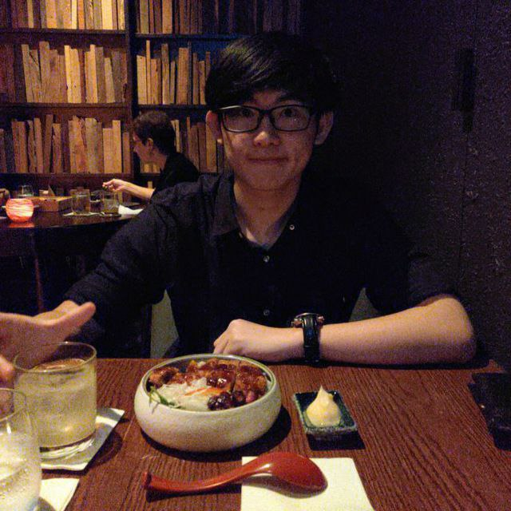
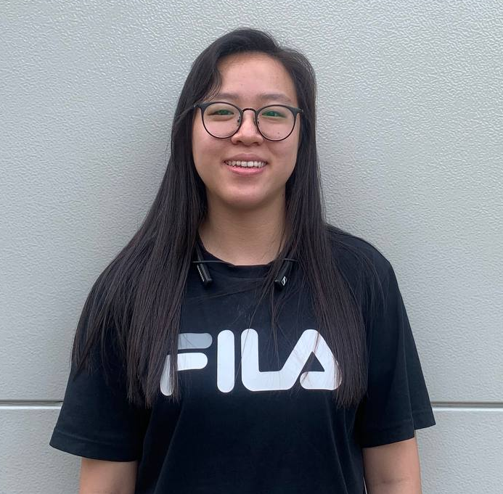
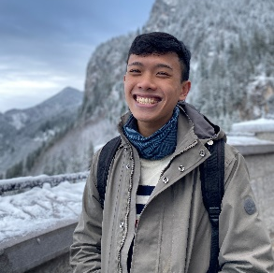
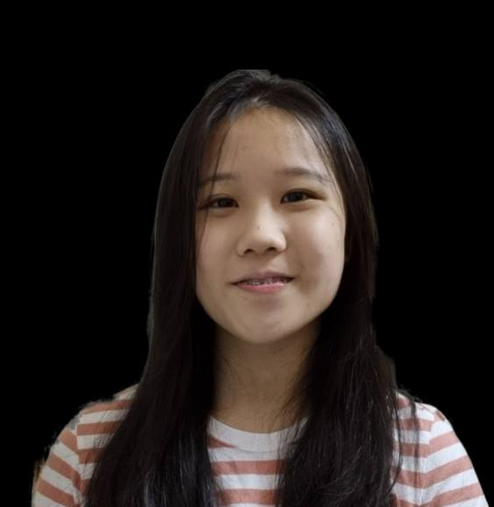
Sharlene World Simulation
Nhieu Chia Xin Yi | 1005646
Ng Jie Lin | 1005476
Danny Yeo Rui Quan | 1005138
Robin Yeo Shao Jie | 1005116
Team 10
Term 6/2023
40.015 Simulation Modelling and Analysis

